Slide 1
Penerapan Komputasi Dalam Pembelajaran Fisika Dasar

Slide 2

Agenda
Pengenalan
Penerapan Excel
Penerapan Python
Penerapan Sympy
Penerapan Numpy dan Matplotlib

Slide 3
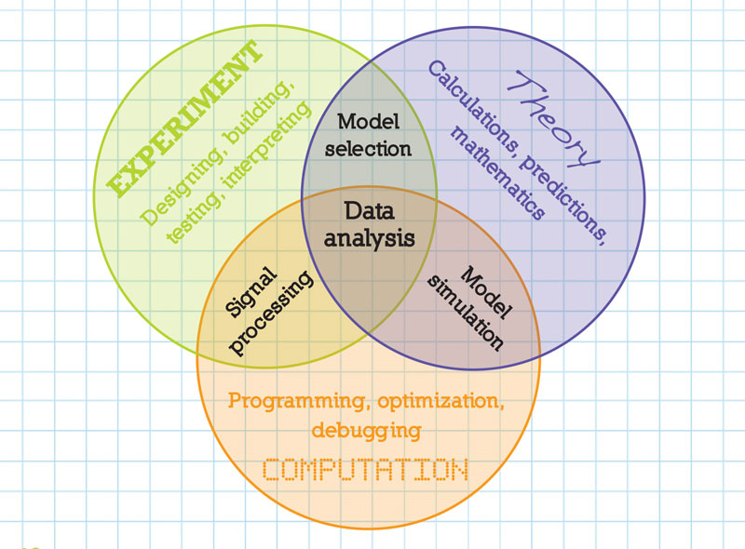
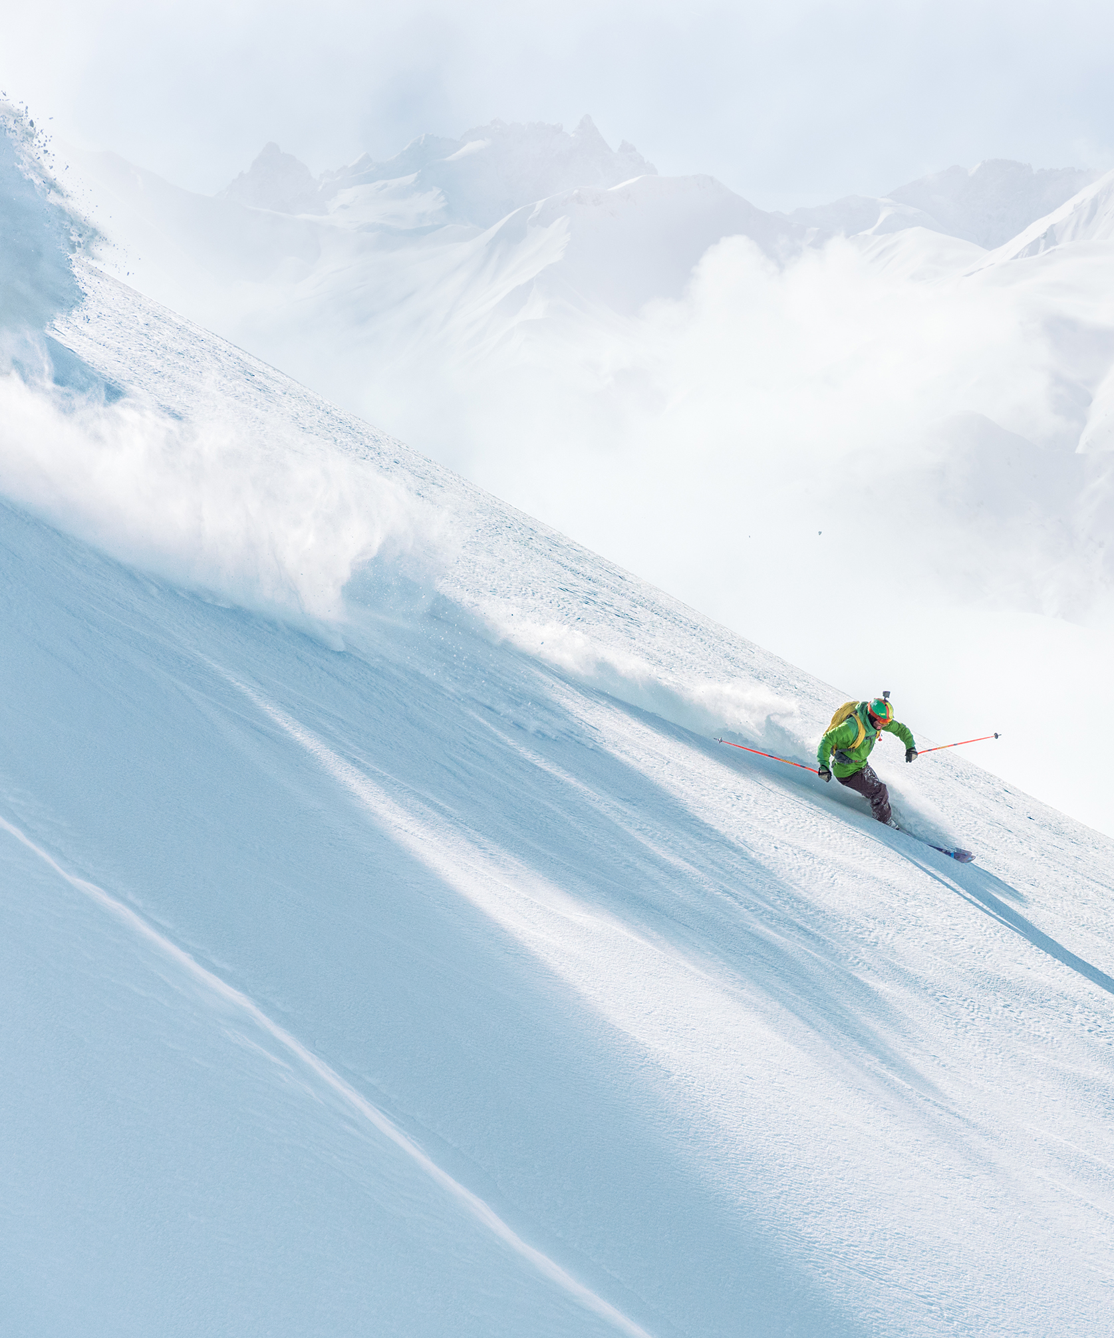
The power of computation
https://www.spsnational.org/the-sps-observer/spring/2015/theory-experiment

Slide 4
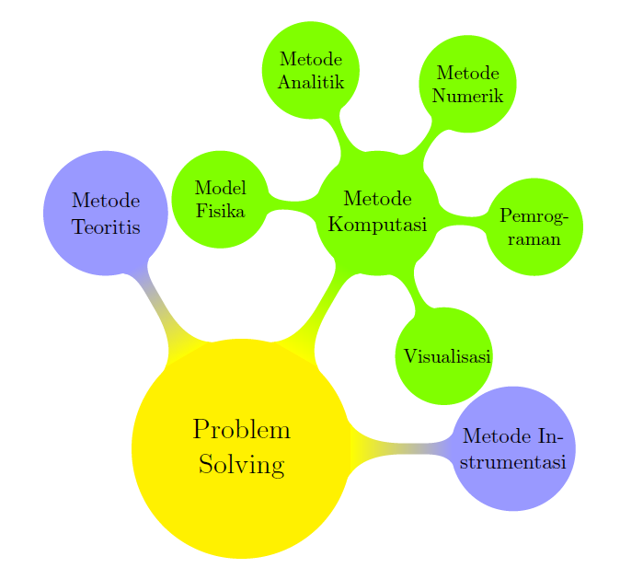
Komputasi untuk Problem Solving

Slide 5

Tools for Computation
Simbolik: MatHEMATICA,MAPLE MAXIMA,SAGEMATH, PYTHON-SYMPY
NUMERIK: MATLAB, OCTAVE, R,EXCEL,PYTHON-NUMPY/SCIPY

Slide 6
Mengapa Python?
1. Python is an interactive language.
2. Python is freely available.
3. Python is widely used in the school.
4. Python is used in the real world

Slide 7
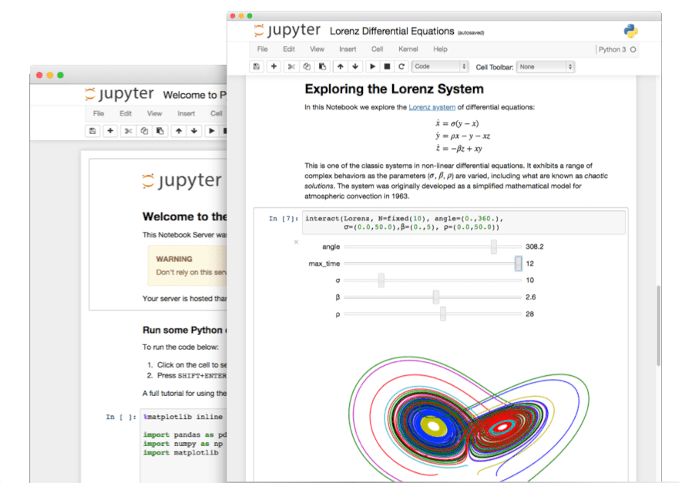
Jupyter Notebook
The Jupyter Notebook is the original web application for creating and sharing computational documents. It offers a simple, streamlined, document-centric experience.
Jupyter.org

Slide 8
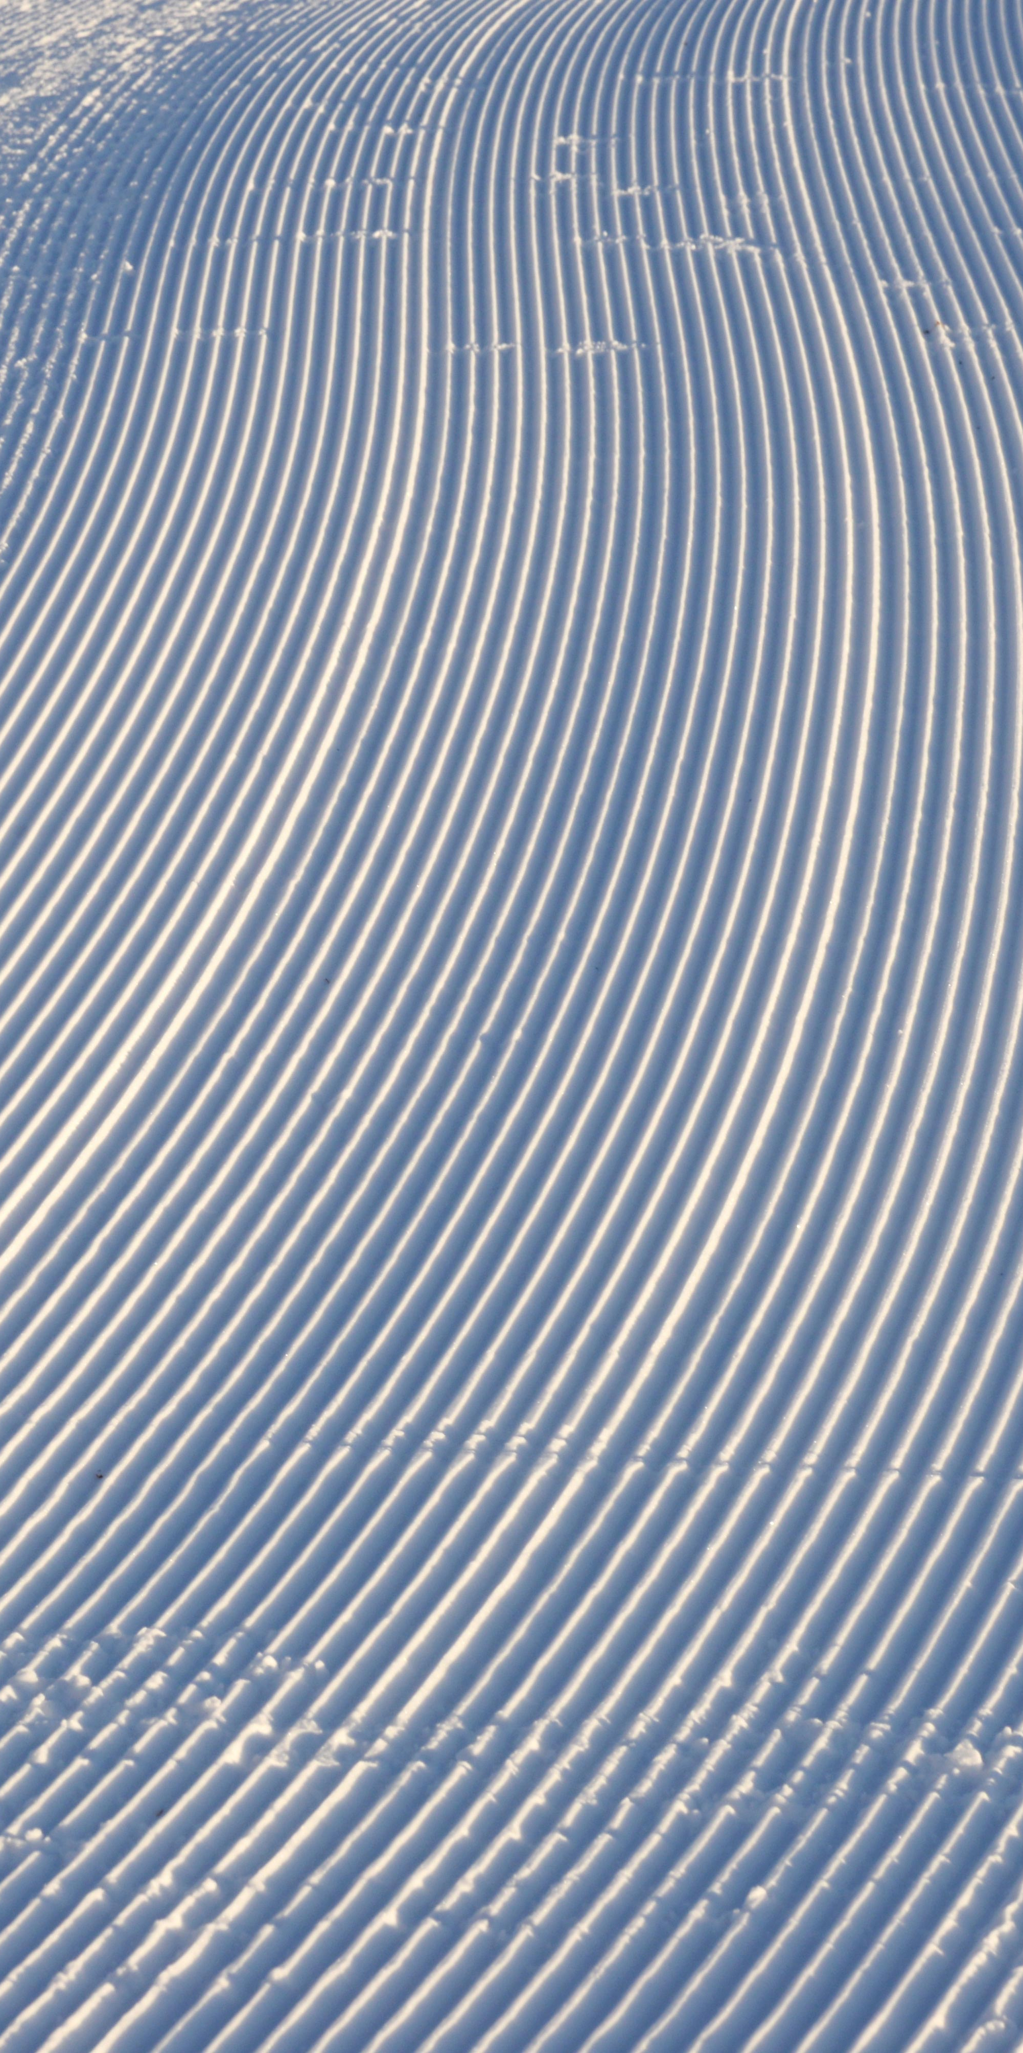
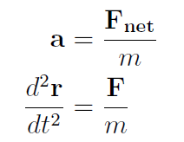
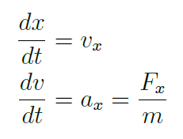
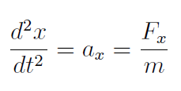
Metode Numerik Persamaan Newton 1D

Slide 9
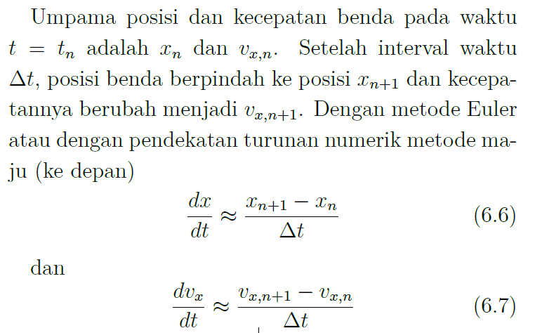
Metode Euler (sederhana)

Slide 10
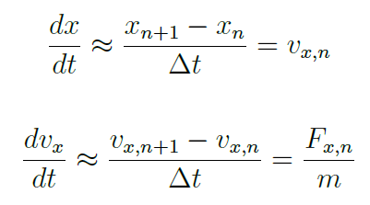
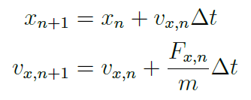
Persamaan Numerik

Slide 11
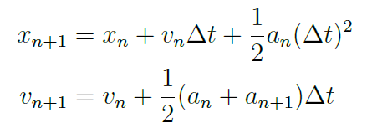
Metode Verlet (lebih akurat)

Slide 12
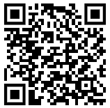
Materi Kuliah Umum
https://github.com/wayansudiarta/komputasi-fisika-dasar

Slide 13
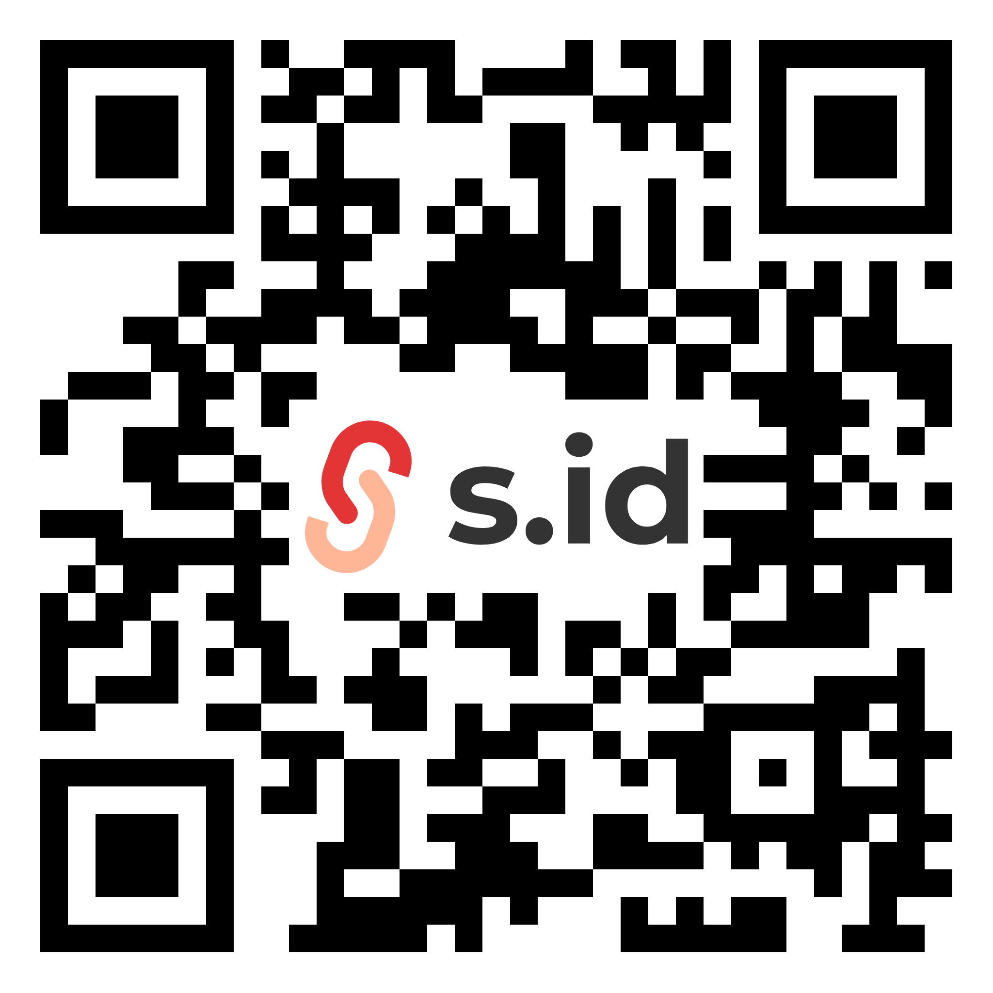
Terima Kasih
I Wayan Sudiarta, Ph.D.
wayan.sudiarta@unram.ac.id
s.id/sudiarta

